Slide 1
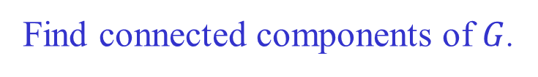

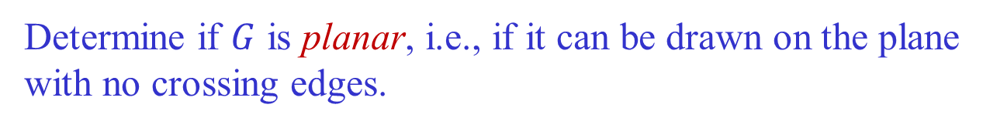

Applications of DFS
In $O(|V| + |E|)$time, we can
Find connected components of $G$.
Determine if $G$ has a cycle.
Determine if removing a vertex or edge will disconnect $G$.
Determine if $G$ is planar, i.e., if it can be drawn on the plane
with no crossing edges.
…

Slide 2
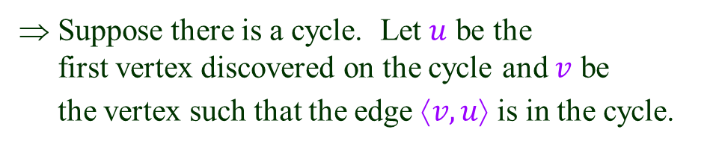
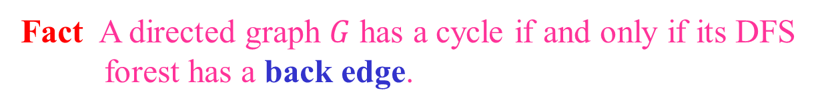
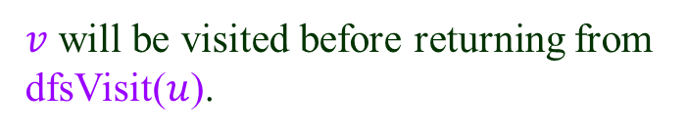
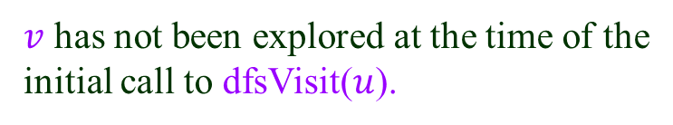
Detecting Cycles
Fact A directed graph $G$ has a cycle if and only if its DFS
forest has a back edge.
a
⇐ A back edge leads to a cycle (adding an
edge to a tree).
b
⇒ Suppose there is a cycle. Let $u$ be the
first vertex discovered on the cycle and $v$ be
the vertex such that the edge $↑v, u$ is in the cycle.
c
$v$ has not been explored at the time of the
initial call to dfsVisit($u$).
v
$v$ will be visited before returning from
dfsVisit($u$).
u
Therefore at the time of visiting $v$, a back edge ⟨$v, u$⟩ will be found.
The fact also holds for an undirected graph.

Slide 3
Using DFS
A back edge can be easily detected during DFS.
root
u
v
We can test if a graph is acyclic in $O(|V|+|E|)$time.

Slide 4
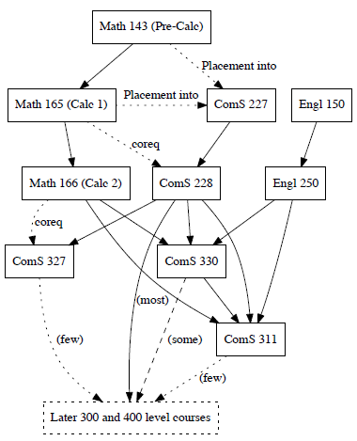
Directed Acyclic Graph (DAG)
Model precedences among events.
Com S course flowchart:
How to plan courses?

Slide 5



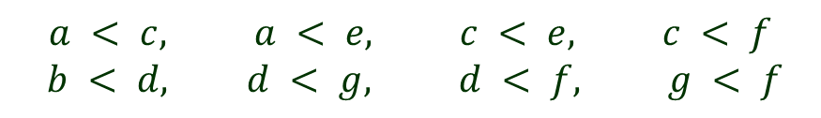



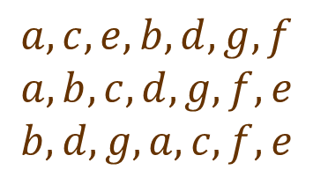


Topological Sort of DAGs
Ordering $<$ over $vertices: u<v$ whenever $↑u, v$ is an edge.
$$a$$
$$b$$
Some topological sorts:
$$a, c, e, b, d, g, f$$
$$a, b, c, d, g, f, e$$
$$b, d, g, a, c, f, e$$
$$c$$
$$d$$
$$e$$
$$f$$
$$g$$
How about $b, a, d, c, e, f, g$?
order violation
$$a < c, a < e, c < e, c < f$$
$$b < d, d < g, d < f, g < f$$

Slide 6
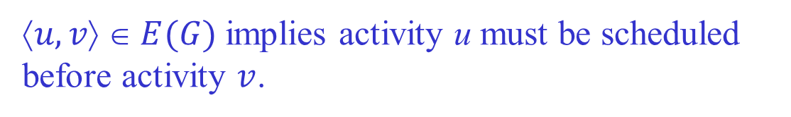
Intuition: Precedence Diagram
Each node represents an activity; e.g., taking a class.
$↑u, v$ $ E(G)$implies activity u must be scheduled
before activity $v$.
Topological sort schedules all activities.
More than one schedule may exist.

Slide 7
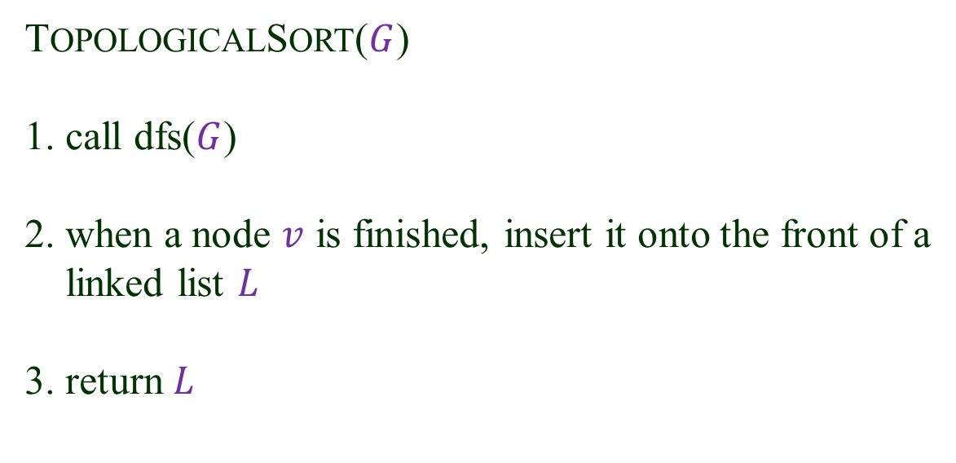
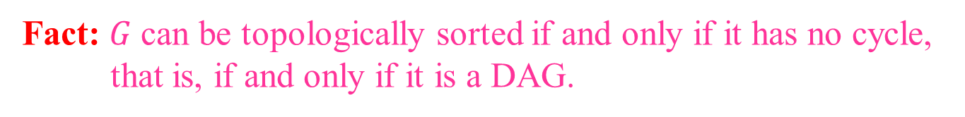
Topological Sort Algorithm
Fact: $G$can be topologically sorted if and only if it has no cycle,
that is, if and only if it is a DAG.
TOPOLOGICALSORT($G$)
1. call dfs($G$)
2. when a node $v$ is finished, insert it onto the front of a
linked list $L$
3. return $L$

Slide 8

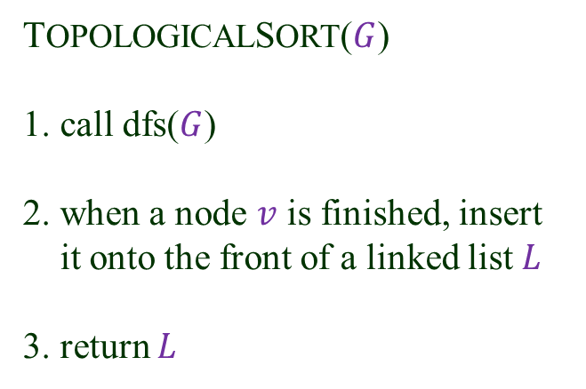






Execution
TOPOLOGICALSORT($G$)
1. call dfs($G$)
2. when a node $v$ is finished, insert
it onto the front of a linked list $L$
3. return $L$
$$a$$
$$b$$
$$c$$
$$d$$
$$e$$
$$f$$
$$g$$
$L$ (with the nodes in a topological order):
$$b$$
$$d$$
$$g$$
$$a$$
$$c$$
$$f$$
$$e$$

Slide 9







Why Correct?
At the moment a node $v$ is finished:
$$v$$
♦ All the nodes in the DFS subtree
rooted at $v$ must have just been
processed.
♦ They are the only nodes dependent
on $v$and thus have to appear after $v$.
♦ They are at the front of L.
♦ The algorithm inserts $v$ just before
them.
$$u$$
$$w$$
…
…
DFS subtree rooted at $v$

